Slide 1
Chapter 10: File-System Interface

Slide 2
Review
Page Replacement （页面置换）
  FIFO、OPT、LRU
  Reference-Bit
  Second-Chance (Clock Algorithm)
  Counting Algorithm
  Allocation of Frames
  固定分配&局部置换
  可变分配&局部置换
  可变分配&全局置换
  Thrashing
  Working-Set
  Allocating Kernel Memory
  Buddy System
  Slab Allocator
  Other Issues
  Prepaging, Page Size, TLB Reach, Program Structure

Slide 3
Chapter 10: File-System Interface
File Concept
Access Methods
Directory Structure
File-System Mounting
File Sharing
Protection

Slide 4
Objectives
To explain the function of file systems
To describe the interfaces to file systems
To discuss file-system design tradeoffs, including access methods, file sharing, file locking, and directory structures
To explore file-system protection

Slide 5
文件是什么？
文件 是 对磁盘的 抽象
所谓 文件 是指 一组带标识（标识即文件名）的、在逻辑上有完整意义的信息项的序列
信息项：构成文件内容的基本单位（单个字节或多个字节），各信息项之间具有顺序关系
文件内容的意义：由文件建立者和使用者解释
信息项 0 | 信息项 1 | … | 信息项 i | … | 信息项 n-1
读写指针
Notes:
进程是对CPU的抽象，物理地址空间是对内存的抽象

Slide 6
文件系统的需求分析
操作系统角度
用户角度
怎么组织、管理文件？
文件的描述、分类
文件目录的实现
存储空间的管理
文件的物理地址
文件系统效率与性能
文件系统如何呈现在用户面前：
一个文件的组织
如何命名？
如何保护文件？
可以实施的操作？
…

Slide 7
What is File System？
文件 是 信息项的序列
文件系统是操作系统中统一管理信息资源的一种软件，管理文件的存储、检索、更新，提供安全可靠的共享和保护手段，并且方便用户使用。
统一管理磁盘空间，实施磁盘空间的分配与回收
实现文件的按名存取
  名字空间 映射 磁盘空间
  实现文件信息的共享，并提供文件的保护、保密手段
  向用户提供一个方便使用、易于维护的接口，并向用户提供有关统计信息
  提高文件系统性能
  提供关于I/O系统的统一接口

Slide 8
File Types
按文件性质和用途分类 （UNIX）
  普通文件
    用户建立和使用的文件，用户委托文件系统保存的文件。如源程序，目标程序，原始数据等。
  目录文件
    管理文件系统的系统文件
  特殊文件（设备文件）
    字符设备文件：和输入输出有关，用于模仿串行I/O设备，例如终端，打印机，网卡等
    块设备文件：磁盘

Slide 9
File Types
按信息保存期限分类：
  临时文件，永久文件，档案文件
按文件的保护方式分类：
  只读文件；读写文件；只执行文件
按信息流向分类：
  输入文件，输出文件，输入/输出文件（存储设备）
按文件中的数据分类：
  源文件；目标文件；可执行文件

Slide 10
File Types
按文件的逻辑结构分类
  从用户角度看文件，由用户的访问方式确定
  流式文件；记录式文件
按文件的物理结构分类：
  顺序（连续）文件；链接文件；索引文件

Slide 11
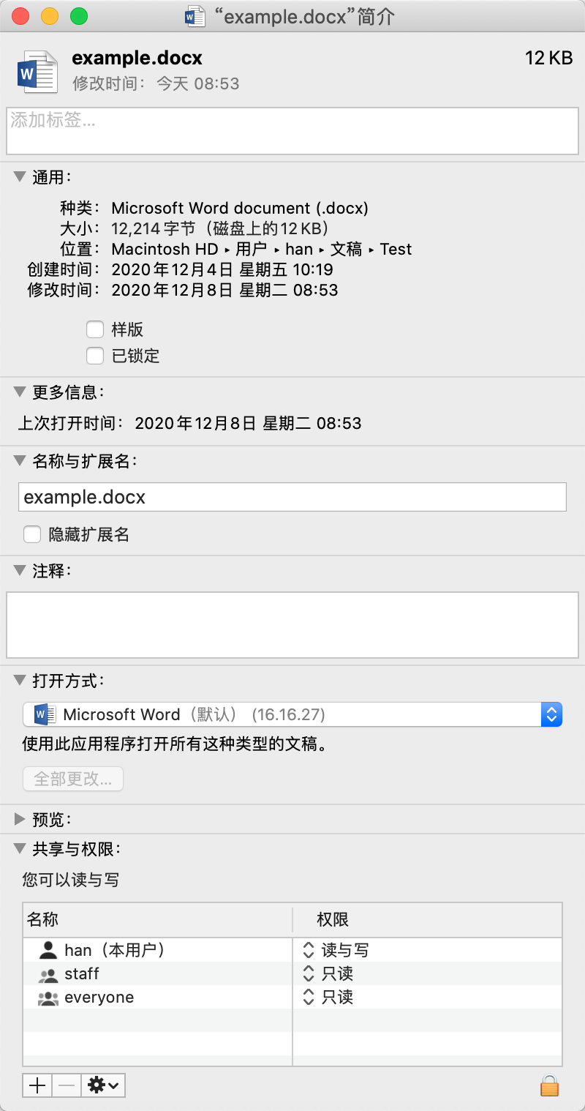
File Attributes（文件属性）
Information about files are kept in the directory structure， which is maintained on the disk.
  Name – only information kept in human-readable form
  Identifier – unique tag (number) identifies file within file system
  Type – needed for systems that support different types
  Location – pointer to file location on device
  Size – current file size
  Protection – controls who can do reading, writing, executing
  Time, date, and user identification – data for protection, security, and usage monitoring
File Control Block (文件控制块，FCB)
  为管理文件而设置的数据结构，保存管理文件所需的所有有关信息（文件属性或元数据）

Slide 12

File Types – Name, Extension
Two major types of files:
  Program files
    Source code
    Object code
    Executable program
  Data files
    Character or ASCII file
    Binary file
There are different subtypes of files.
  They are often indicated by the file extension.

Slide 13
File Operations
File is an abstract data type
Basic file operations
  Create
  Write
  Read
  Reposition within file (Seek)
  Delete
  Truncate(截断)
  Get Attributes
  Set Attributes
  Rename
  Copy
  …

Slide 14

File Operations
Create
  建立系统与文件的联系，实质是建立文件的FCB
  Makes an entry in the file directory
  Allocates disk space
Create(文件名，访问权限)
检查参数的合法性
例如：文件名是是否符合命名规则；
有无重名文件；
合法-> ； 否则->报错、返回
申请空闲FCB，并填写相关内容
为文件申请磁盘块
返回

Slide 15
File Operations
Delete
  Searches the directory
  Releases all file space
  Erases the directory entry for the file

Slide 16
File Operations
Read
  requires specifying file name and the memory location where the next block of the file to be put
  Searches the directory to find the file’s location
  Reads the block of the file into memory
  Updates the read pointer

Slide 17
File Operations
Read(文件描述符，读指针，要读的长度，内存目的地址)
根据打开文件时得到的文件描述符，找到相应的FCB
确定读操作的合法性
读操作合法 -> ； 否则->出错处理
将文件的逻辑块号转换为物理块号
根据参数中的读指针、长度与文件控制块中的信息，确定块号、块数、块内位移
申请缓冲区吗，如果内容已经在缓冲区中，直接拷贝到用户区；否则，
启动磁盘I/O操作，把磁盘块中的信息读入缓冲区，再传送到指定的内存区（多次读盘）
  性能、安全性和硬件限制
反复执行3、4直至读出所需数量的数据

Slide 18
内存映射文件 vs read/write系统调用
维度 | 内存映射文件（Mmap） | read/write
数据拷贝 | 零拷贝（直接访问Page Cache） | 2次拷贝（内核↔用户）
内存占用 | 共享Page Cache，节省内存 | 用户空间需独立存储数据副本
访问模式 | 随机访问最优 | 顺序访问最优
大文件支持 | 按需加载，高效 | 需手动分块处理
多进程共享 | 天然支持（映射同一文件） | 需额外同步机制
控制粒度 | 依赖页大小（如4KB） | 可精确控制字节级I/O
安全性 | 依赖MMU保护，需防范缺页攻击 | 内核校验，隔离性更强

Slide 19
File Operations
Write
  requires specifying file name and the information to be written to the file
  Searches the directory to find the file’s location
  Writes to the file according to the write pointer to the location in the file
  Updates the writer pointer

Slide 20
File Operations
Repositioning within a file
  Known as a file seek
  Searches the directory to find the file’s entry
  Updates the current-file-position pointer to a given value
Turncate 截断
  Erases the contents of a file but keeps its attributes
    Only the file length be reset to 0
  Releases its file space
Notes:
Turncate :截断文件,只删除文件内容而保留其属性,即将其长度修改为0.

Slide 21
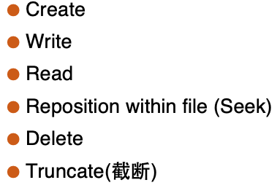
用基本文件操作构造copy操作
/*File copy program. Error checking and reporting is minimal.*/
int main(int argc, chaar *argv[])
{
/*Open the input file and create the output file */
in_fd = open(argv[1], O_RDONLY); /*open the source file */
if(in_fd <0) exit(2); /*if it cannot be opened, exit */
out_fd = create(argv[2], OUTPUT_MODE) ; /*create the destination file*/
if(in_ out <0) exit(3); /*if it cannot be opened, exit */
}

Slide 22
用基本文件操作构造copy操作(续)
/*Copy loop*/
while(TRUE){
rd_count = read(in_fd, buffer, BUF_SIZE); /*read a block of data */
if(rd_count <=0) break; /*if end of file or error, exit loop*/
wt_count = write(out_fd, buffer, rf_count) /*write data*/
if (wt_count <=0) exit(4); /* wt_count <=0 is an error*/
}
/*Close the files*/
close(in_fd);
close(out_fd);
if (rf_cout ==0) exit(0); ); /* no error on last read*/
Else
exit(5);
}
}
Notes:
在此基础上，rename操作可以再加一个delete就可以实现。
另一种方式，直接实现：找到目录条目，修改文件名。

Slide 23
File Operations
Besides the basic operations, two more common operations are often provided in the implementation of most file systems.
Open(F_{i}) :make a file ready for reading/writing.
  searches the directory structure on disk for entry F_{i}
  moves the content of entry to memory
Close (F_{i}) : mark the completion of operation on file.
  moves the content of entry F_{i} in memory to directory structure on disk

Slide 24
Open Files
Most of the file operations involve searching the directory for the entry of the named file.
To avoid this constant searching, many OS require that an open() system call be made before a file first used actively.
The OS keeps a small table, called the open-file table, containing information about all open files.
The open() takes a file name and searches the directory, copying the directory entry into the open-file table.
The open() system call typically returns a pointer to the entry in the open-file table.
根据文件名在文件目录中检索，并将该文件的目录项读入内存，建立相应的数据结构（系统打开文件表、用户打开文件表），为后续的文件操作做好准备。返回文件描述符/文件句柄。

Slide 25
File Operations
Open 为文件读写做准备
  给出文件路径名，获得文件描述符，将该文件的目录项读入内存
fd = Open(文件路径名，打开方式)
根据文件路径名查目录，找到目录项（或i节点号）
根据文件号查系统打开文件表，看文件是否已打开
  是→共享计数+1；否→将目录项等信息填入系统打开文件表空表项，共享计数置为1；
根据打开方式、共享说明和用户身份检查访问合法性；
在用户打开文件表中获取一空表项，填写打开方式等，并指向系统打开文件表对应表项
  返回信息：fd：文件描述符，是一个非负整数，用于以后读写文件

Slide 26
Open Files
There may be several processes opening the same file at the same time.
OS uses two levels of internal tables:
  Process open-file table
    Tracks all files opened by a process
    Stores information about the use of the file, e.g. current file pointer, access rights and accounting information.
    Each entry in process open-file table in turn points to a system-wide open-file table.
  System open-file table
    Contains process-independent information, such as the disk location of the file, access date, file size and open count.

Slide 27
Open Files
Several pieces of data are needed to manage open files:
  File pointer: pointer to last read/write location, per process that has the file open
  File-open count: counter of number of times a file is open – to allow removal of data from open-file table when last processes closes it
  Disk location of the file: the information to locate the file on the disk
  Access rights: per-process access mode information

Slide 28
Open File Locking
Provided by some operating systems and file systems
File locks allow one process to lock a file and prevent other processes from gaining access to it.
File locks are useful for files that are shared by several processes—for example, a system log file that can be accessed and modified by many processes in the system.
File locks provide functionality similar to reader-writer locks.
  Shared lock共享锁: like reader lock, allowing reading currently
  Exclusive lock独占锁: like writer lock, only one process can acquire at a time.

Slide 29
Open File Locking
Further more, OS may provide either mandatory or advisory file-locking mechanisms.
  Mandatory 强制
    Once a process acquires an exclusive lock, the OS will prevent any other process from accessing the locked file, Even if other process will not modify the file.
    OS ensures locking integrity 完整性.
    Windows
  Advisory 建议
    Processes can find status of locks and decide what to do
    Software developers ensure that locks are appropriately acquired and released.
    Unix
二者的主要区别在于操作系统如何处理违反文件锁规则的程序。

Slide 30
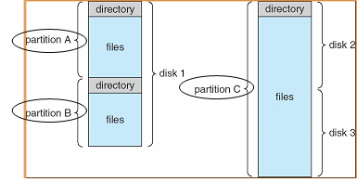
Disk Structure
A disk may be divided into many parts.
  A part may hold an individual file system.
  This is called a partition (分区).
Sometimes, several disks are combined together to hold one large file system.
  This collection of disks is also called a partition

Slide 31
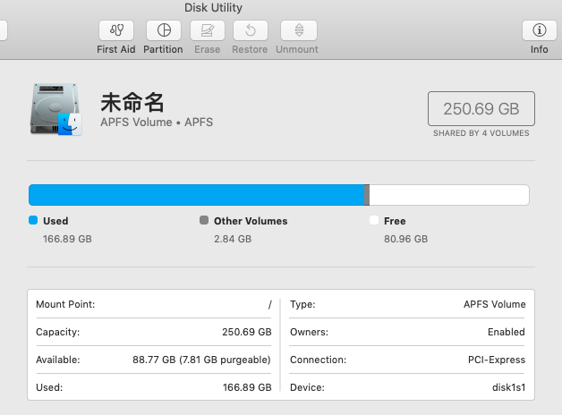
Disk Structure

Slide 32
Disk Structure
Disk or partition can be used raw – without a file system, or without formatted with a file system
Partitions also known as minidisks, slices
Partition containing file system known as a volume (卷)
Each volume containing file system also tracks that file system’s info in device directory(设备目录) or volume table of contents(卷目录表)
There may be several file systems, frequently all within the same operating system or computer

Slide 33
文件结构与存储设备
用户和文件系统往往从不同角度对待同一个文件：
  用户:从使用的角度，按信息的使用和处理方式组织文件。
  文件系统：从文件的存储和检索的角度，根据用户对文件的存取方式和存储介质的特性组织文件，决定用户文件存放在存储介质上的方式。
文件有两种形式的结构：逻辑结构和物理结构
  逻辑结构：从用户的角度看文件，由用户的访问方式确定。
  物理结构：文件在外存储器上的存储结构
  物理结构直接影响存储空间的使用和检索文件信息的速度
  逻辑文件保存到存储介质上的工作由文件系统来做，这样可以减轻用户的负担。根据用户对文件的存取方式和存储介质的特性，文件在存储介质上可以有多种组织形式。

Slide 34
文件的逻辑结构
流式文件
  构成文件的基本单位：字节流
  文件是有逻辑意义、无结构的一串字符的集合，文件的结构不强烈依赖数据项之间的关系
  读取时通常是顺序的，适用于大规模、连续流入的数据
  例子：音频文件、视频文件、日志文件等
记录式文件
  文件由若干记录组成，可以按记录进行读、写、查找等操作，记录之间具有逻辑关系
  每条记录有其内部结构
  可以顺序访问或随机访问
  例子：CSV文件、数据库文件、XML文件等
1 Record
关键字
关键字
1 Byte
流式文件
记录式文件

Slide 35
文件的逻辑结构-顺序文件
（Sequential File）
顺序文件的所有记录按键值的约定次序组织；
记录可以是定长的，也可以是变长的；
顺序文件常用于批量记录读取，对于访问某个记录的请求则处理性能不佳；
对于定长记录文件，若要查找第i个记录，可根据下式得到相对于第一个记录首址的地址：A_{i} = i*d（d为记录的长度）；
对于非定长的记录文件，若要查找第i个记录，则需要有每个记录的长度：A_{i} = Σd_{i}（d为记录的长度）。
Notes:
非定长记录想要随机访问，建立索引

Slide 36
文件的逻辑结构-索引文件
（Indexed File）
为解决这类问题，往往建立一张索引表，记录下每个记录的长度及指向该记录的指针，从而方便了直接存取；
索引文件对主文件中的记录按需要的数据项（一个或几个）建索引表；
为每个记录设置一个表项；

Slide 37
文件的逻辑结构-索引顺序文件
（Indexed Sequential File）
索引顺序文件是基于键的约定次序组织的。将顺序文件中的所有记录分为若干个组；
再为顺序文件建立一张索引表，表中记录每个组的第一个记录，该索引项包含记录的键值和指向该记录的指针。它是顺序文件和索引文件的结合。
检索时，先根据关键字去检索索引表，找到该记录所在组的第一个记录的位置，然后再利用顺序查找法查找主文件，找到所需记录。

Slide 38
索引顺序文件
姓名 | 其他属性
An Bing
An Kang
An Qing
Bao Rong
Bi Jing
Bon Long
关键字 | 逻辑地址
A
B
Z
索引文件
顺序文件
还可以组织成堆、散列等结构

Slide 39
File Access Methods
The information in the file can be accessed in several ways.
Some systems only support some of them.
  Sequential Access: simplest
  Direct Access
  Indexed access

Slide 40
Access Methods
Sequential Access: simplest
  Information in the file is processed in order, one record after the other.
  read_next(): read the next portion of the file and automatically advances a file pointer
  write_next(): appends to the end of the file and advances to the new end of the file
  Reset: moves the file pointer to the beginning
  Skip forward/backward: move the file pointer forward without reading or move it backward.
    is only supported in some systems.
  Most systems support sequential access.

Slide 41

Sequential-access File

Slide 42
Access Methods
Direct Access: or relative access
  Based on a disk model of a file
  The file is viewed as a numbered sequence of blocks or records.
  There are no restrictions on the order of reading or writing for a direct-access file.
  Are useful for immediate access to large amounts of information, for example, database query
  For the direct-access method, the file operations must be modified to include the block number as a parameter.
    read n: return the n^{th} data item or block.
    write n: update the n^{th} data item or block
    A system that provides sequential access operations Read_next and Write_next can support the two direct access operations above through a new operation Position n.
      Position n: move the file pointer to the nth data item or block.
      Read n and Write n could be implemented using Position n and then Read next and Write next.

Slide 43

Simulation of Sequential Access on Direct-access File
Sequential access can also be provided easily by a system that only supports direct access.
Keep a variable cp that defines the current position

Slide 44

Other Access Methods
Other access methods can be built on top of a direct-access method.
These methods generally involve the construction of an index for the file.

Slide 45
Directory Structure
Some systems store millions of file on disk.
To manage all these data, we need to organize them.
This organization involves the use of directory.
A directory is a collection of nodes containing information about all files.

Slide 46

文件目录、目录项与目录文件
文件目录
  统一管理每个文件的元数据，以支持文件名到文件物理地址的转换
  将所有文件的管理信息组织到一起，即构成文件目录
  文件目录是用于检索文件的，它是文件系统实现按名存取的重要手段，它的组织和管理应便于检索和防止冲突；
  目录项：构成文件目录的基本单位（目录项是FCB，文件目录是文件控制块的有序集合）。
目录文件：为了实现对文件目录的管理，将文件目录以文件的形式保存在外存，这个文件就叫目录文件
目录结构的组织关系到：
  文件的存取速度
  文件共享性和安全性

Slide 47
Directory Structure
Both the directory structure and the files reside on disk
Backups of these two structures are kept on tapes
Directory
Files
F 1
F 2
F 3
F 4
F n

Slide 48
Operations Performed on Directory
The directory can be viewed as a symbol table that translates file names into their directory entries.
Operations performed on a directory:
  Search for a file
  Create a file
  Delete a file
  List a directory 遍历目录
  Rename a file
  Traverse the file system 遍历文件系统

Slide 49
Organize the Directory (Logically) to Obtain
Efficiency – locating a file quickly
Convenient to users
  Naming
    Two users can have same name for different files
    The same file can have several different names
  Grouping – logical grouping of files by properties, (e.g., all Java programs, all games, …)

Slide 50

Single-Level Directory
A single directory for all users
Naming problem
Grouping problem
Searching problem: time consuming

Slide 51

Two-Level Directory
Separate directory for each user
主文件目录：
给出用户名，用户子目录
所在的物理位置
用户文件目录：
给出该用户所有
文件的FCB
Path name
Can have the same file name for different user
Efficient searching
No grouping capability

Slide 52

Tree-Structured Directories
Extend two-level directory into multiple levels like a tree
思考：
在Unix/Linux系统中，根目录的文件名是什么？
目录也是文件，因此也有文件名，其文件名保存在上一级目录
文件中。
Unix/Linux系统中，使用“/”表示根目录，但“/”知识路径的分隔符，
用于分隔不通层次的目录和文件，使用“/”表示根目录仅是一种约定，
根目录文件名是在“/”之前，因此没有。
文件ABC
路径名：/spell/mail/prog/list/ABC

Slide 53
Tree-Structured Directories (Cont)
Efficient searching
Grouping Capability
A current working directory is maintained to define the default searching place for files.
  Path names should be given to locate for a file.
  Can use absolute or relative path names (from the current working directory).
Adopted in MS-DOS.
Notes:
./是当前目录 ../是父目录 /是根目录
使用当前目录更加灵活

Slide 54
Tree-Structured Directories (Cont)
Absolute or relative path name
Creating a new file is done in current directory
Delete a file
rm <file-name>
Creating a new subdirectory is done in current directory
  mkdir <dir-name>
Example: if in current directory /mail
mkdir count
mail
prog
copy
prt
exp
count
Deleting “mail” ⇒ deleting the entire subtree rooted by “mail”

Slide 55
Tree-Structured Directories (Cont)
优点
层次结构清晰
便于管理与保护
有利于文件分类
解决重名问题
提高文件检索速度
缺点
查找一个文件按路径名逐层检查，由于每个文件都放在外存，多次访盘影响速度
不支持共享

Slide 56

Acyclic-Graph Directories 无环图目录
Have shared subdirectories and files

Slide 57
Acyclic-Graph Directories (Cont.)
An acyclic-graph directory structure is more flexible than a simple tree structure, but it is also more complex.
A common way is to create a new directory entry called a link.
  A link is effectively a pointer to another file or subdirectory.
Several problems:
  A file may have multiple absolute path names.
  File deletion: when can the space allocated to a shared file be deallocated and reused?

Slide 58
Acyclic-Graph Directories (Cont.)
Problems about deleting sharing files
If remove the file whenever anyone deletes it, there may be dangling pointers(悬挂指针) to the nonexistent file.
Solutions:
  Sharing by hard link (nonsymbolic links) 非符号链接
    Entry-hold-count solution
    Unix iNode
  Sharing by symbolic links 符号链接
    Deletion of a link: do not affect the original file
    Deletion the shared file: the space for the file is deallocated, leaving the links dangling, we can leave the links until an attempt is to made to use them—treat as an illegal file access.
      Unix and Windows do like this.
Notes:
两种解决方案：符号链接，也叫软链接
虽然Windows系统的快捷方式在许多情况下都非常有用，但有些情况下使用软链接可能会更加合适：
1. **应用程序兼容性**：有些应用程序可能会更好地理解和处理软链接，尤其是那些设计用于Unix或类Unix环境的应用程序。因为在这些环境中，软链接是非常常见的。
2. **文件系统级别的引用**：软链接在文件系统级别上创建了一个引用，这意味着它们可以被文件系统操作（如复制和移动）识别和保留。而快捷方式是特定于Windows shell的，并不会被所有文件系统操作所识别。
3. **在命令行环境中使用**：如果你正在使用命令行环境（比如PowerShell或cmd），软链接可能会更容易处理，因为它们会像普通文件或目录一样表现。
4. **目标文件被移动或重命名时的行为**：如果一个软链接的目标被移动或重命名，软链接将继续指向原始的路径（虽然这可能导致“死链接”）。然而，如果一个快捷方式的目标被移动或重命名，快捷方式将尝试更新其路径以指向新的位置。
需要注意的是，创建和使用软链接通常需要更高的权限，并且可能需要对文件系统有更深入的理解。

Slide 59
文件别名实现
（1）基于索引结点（index node）的非符号链接：也称为硬链接（hard link），基于改进的多级目录结构，将目录内容分为两部分——文件名和索引结点。前者包括文件名和索引结点编号（目录），后者包括文件的其他内容（包括属主和访问权限）。
- 一个文件的文件名与该文件的iNode并没有直接绑定，而是通过目录项实现两者的映射
- 通过多个文件名链接（link）到同一个索引结点，可建立同一个文件的多个彼此平等的别名。
- 别名的数目记录在索引结点的链接计数中，若其减至0，则文件被删除。
文件名与链接的区别？
从文件系统角度看，二者没有区别，都保存在目录项中，映射到
一个inode号。
但出于习惯，通常将文件创建时使用的字符串称为文件名，而通
过链接命令创建的文件名称为链接。

Slide 60













基于索引节点的共享方式
C的目录
B的目录
C的目录
B的目录
Owner = C
Count = 1
Owner = C
Count = 2
Owner = C
Count = 1
链接前
建立链接后
拥有者删除文件后
进程B链接前后的情况

Slide 61
文件别名实现
硬链接的限制：
为一个文件新建的链接必须和这个文件在同一个文件系统中。
如何实现跨文件系统的链接呢？？
（2）基于符号链接（symbolic link, shortcut）:特殊类型的文件，其内容是到另一个目录或文件路径的链接。
建立符号链接文件，并不影响原文件，实际上它们各是一个文件。因此，可以保存在不同的文件系统中，实现跨文件系统的链接。
软链接和目标文件是独立的，拥有各自的inode，因此，即使目标文件不存在，软链接也可以存在，只是访问的时候会报错。
与硬链接不同，软链接可以指向目录。但为了防止无限深的路径，通常需要设置深度阈值，超过则报错。

Slide 62
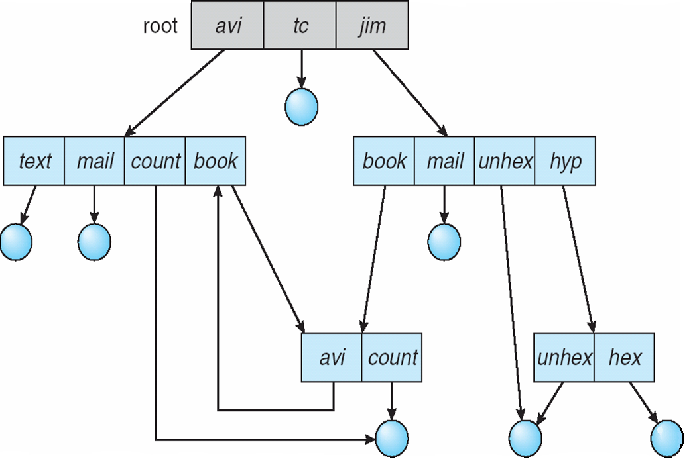
General Graph Directory 通用图目录
Allow for cycles in directories to exist to form general graph.
Notes:
如果允许链接指向目录，就会形成通用图目录。
通用图存在环路。存在问题：统计有多少文件时，会有循环；

Slide 63
General Graph Directory (Cont.)
The general graph with a cycle could cause some problems.
  How to count the total number of files?
    A poorly design algorithms will fall into an infinite loop.
  If we need a recursive backup of all the files down the directories, how can that be done?
  How can we delete a file using reference count?
    Without cycle, a deleted file has a reference count of zero.
    With cycle, deleted files may have reference count greater than zero.
    Garbage collection techniques are needed, but garbage collection algorithms are expensive to run.
We could prevent the problems from happening.
  Ensure that there is no cycle in the graph.
    Allow only links to file, not subdirectories.
    Every time a new link is added, use a cycle detection algorithm to determine whether there is a cycle created.
限制搜索时访问目录的数量
Notes:
Garbage collection:当删除一个文件时,由于存在环路(自引用),则存在文件的引用计数不为0的问题,从而该文件的存储空间无法回收,这就需要系统定期进行清理
垃圾收集算法性能不好。很多时候不采用通用图，因为性能不够好。
不希望目录里出现环，解决方案？不允许对目录创建链接，就不会有环。

Slide 64
File System Mounting
A file system must be mounted before it can be accessed 挂载
How to mount?
  The OS is given the name of the device and the mount point—the location within the directory structure where the file system is to be attached.
    Typically, a mount point is an empty directory.
  Then, the OS verifies that the device contains a valid file system
  Finally, the OS notes in its directory structure that a file system is mounted at the specified mount point.

Slide 65

(a) Existing. (b) Unmounted Partition
A unmounted file system (i.e. Fig. (b)) is mounted at a mount point
Existing file system
Unmounted volume

Slide 66

Mount Point
在非空目录上进行挂载操作
挂载点在挂载时，并不要求是
空目录。挂载点原有的内容会
被临时“覆盖”，但并不会丢
失。当所挂载的文件系统被卸
载时，这些原有内容又可以再
次被访问。

Slide 67
File Sharing – Multiple Users
For multiple users, the issues of file sharing, file naming, and file protection become preeminent.
To implement sharing and protection, the system must maintain more file and directory attributes than are needed on a single-user system.
File owner user, group user, other user
  User IDs identify users, allowing permissions and protections to be per-user
  Group IDs allow users to be in groups, permitting group access rights

Slide 68
File Sharing– Remote File Systems
Uses networking to allow file system access between systems
  Manually via programs like FTP (File Transfer Protocol)
    FTP是用于在网络上进行文件传输的一套标准协议,基于客户—服务器（C/S）模型而设计的,定义了如何在客户端和服务器间交换文件。允许用户以文件操作的方式（如文件的增、删、改、查、传送等）与另一主机相互通信,双方计算机可能配有不同的操作系统和文件存储方式。
  Automatically, seamlessly using distributed file systems (remote directories are visible from a local machine.)
  Semi automatically via the world wide web

Slide 69
File Sharing– Remote File Systems
Client-server model allows clients to mount remote file systems from servers.
  客户端-服务器模型是一种网络架构模型，该模型基于“请求-响应”模式，其中客户端发起请求，服务器提供相应的服务。是一种通用的网络通信模型，并不局限于某一种协议（FTP、HTTP、SMTP等）。
  Server: machine containing the files
  Client: machine seeking access to the files
  A server can serve multiple clients.
  Standard operating system file calls are translated into remote calls to be executed at the remote machine.

Slide 70
File Sharing
Network File System (NFS) developed by Sun is a common distributed file-sharing method.
  It is the standard Unix client-server file sharing approach.
  使用RPC（远程过程调用）机制来实现远程操作文件系统，通常基于TCP或UDP协议进行通信。
Storage Area Network (SAN 存储区域网络) is a current technology to provide large storage capacities to a large user population.
  It is a high-speed network dedicated to the task of transporting data for storage and retrieval.
  It connects together computers and storage devices to allow sharing of the pool of storage devices.
  It is adopted by large institutions.
Cloud storage is the newest technology to host data in a collection of nodes over the cloud.
  Service is usually provided by third party, usually data center.
  Common storage: iCloud, dropbox, Google drive.

Slide 71
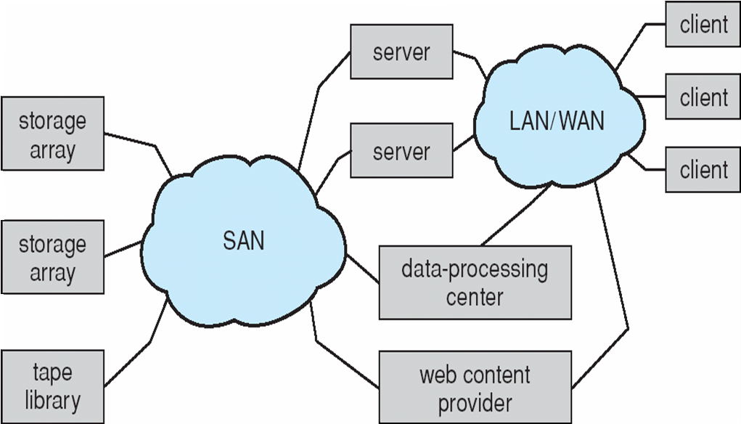
Storage Area Network
Common in large storage environments (and becoming more common)
Multiple hosts attached to multiple storage arrays – flexible
SAN是一个专用的网络，专门用于连接数据存储设备与服务器的网络架构
采用块级协议（如Fibre Channel、iSCSI）提供存储访问，高性能、低延迟，适用于高吞吐量需求
Notes:
存储区域网络(Storage Area Network)，是一种架构，用在应用服务器和存储资源之间的专用的高性能的网络体系，在多台主机和多个存储设备之间提供任意两个结点之间的通信通道
通常用在大型企业，如银行

Slide 72
Protection
File owner/creator should be able to control:
  what can be done
  by whom
Types of access
  Read
  Write
  Execute
  实现：
    用户身份验证
      口令、密码、回答问题、指纹、虹膜…
    访问控制

Slide 73
Access control
The most general scheme is to associate with each file and directory an access-control-list (ACL).
  showing who can do what.
Consider Unix/Linux，采用文件的二级存取控制
  审查用户身份、审查操作的合法性
  第一级：对访问者的识别
    Three classes of users: owner, group, other (public or universe).
  第二级： 对操作权限的识别
    Three modes of accesses: read, write, execute.
  For example, the command chmod 751 game will define the access control list on game to be something like
      <owner: read, write, execute>
      <group: read, execute>
      <other: execute>

Slide 74
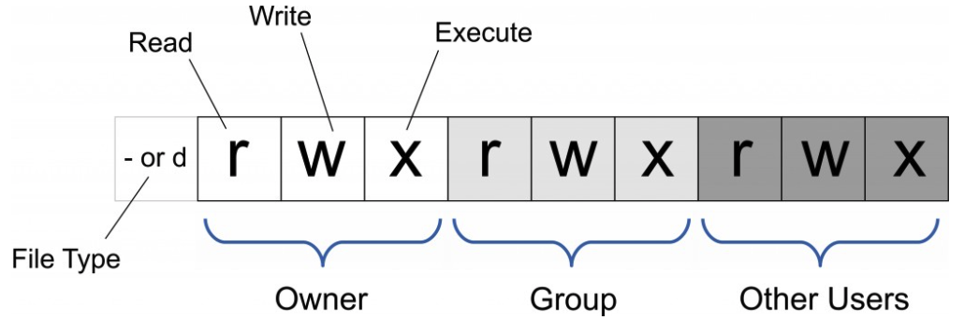
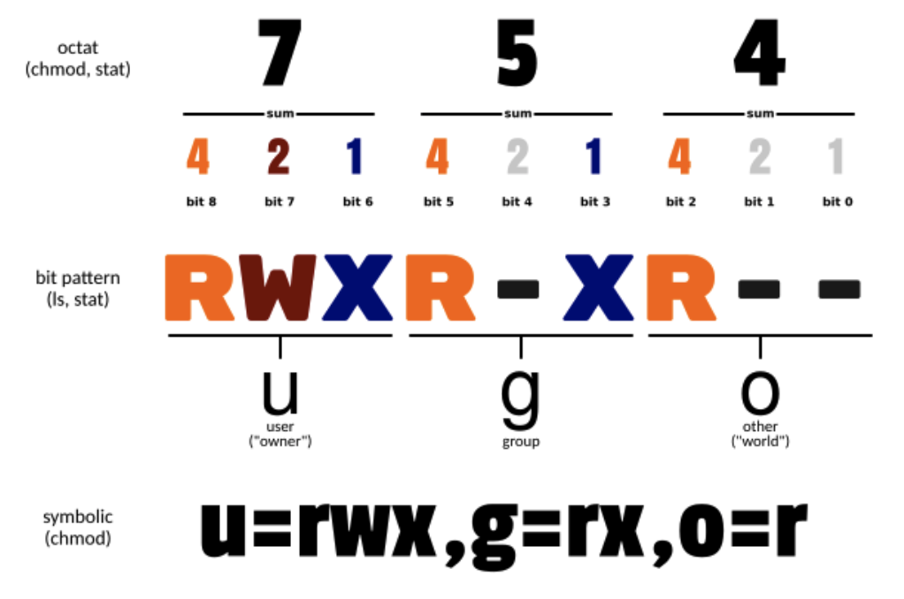

Slide 75

A Sample UNIX Directory Listing
ls –l who can do what

Slide 76
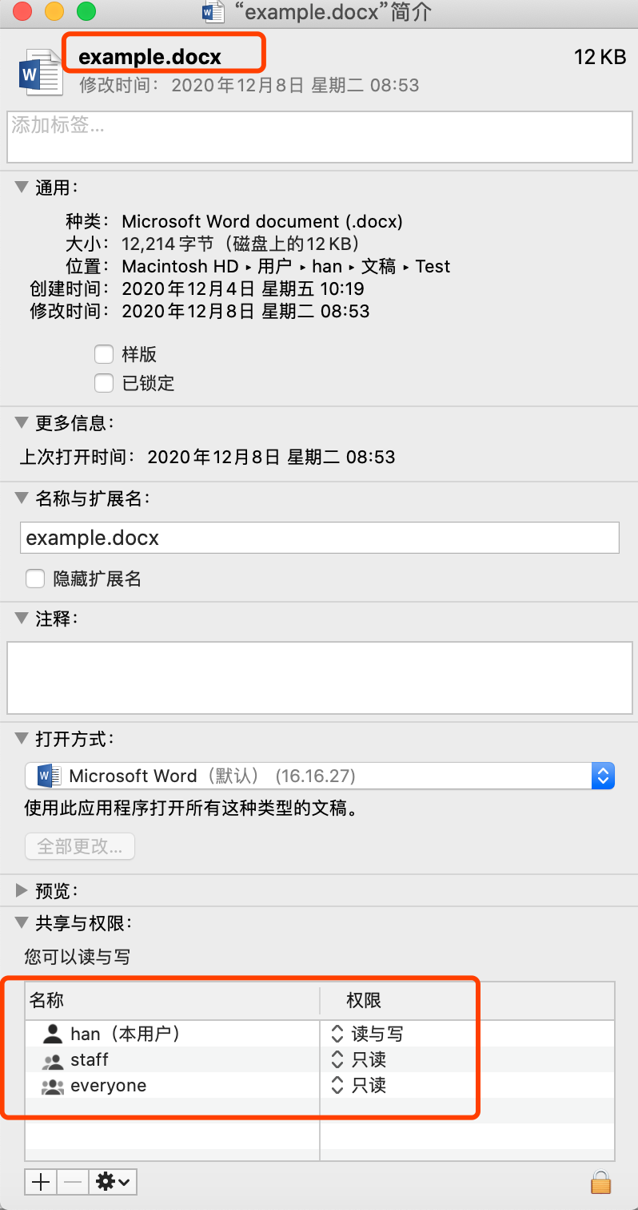
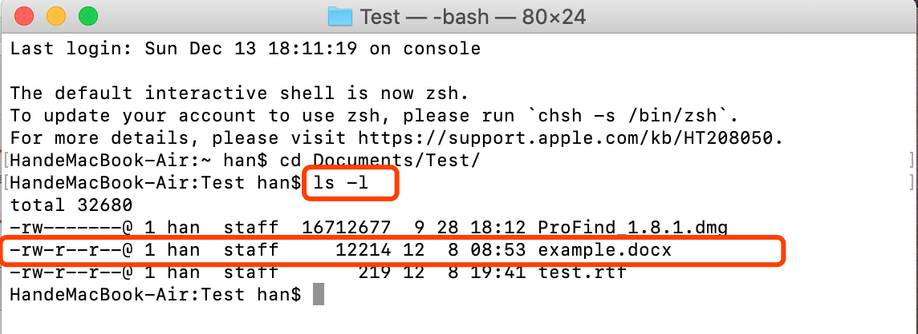

Slide 77

Windows XP Access-control List Management

Slide 78
End of Chapter 10

